Slide 1
PGST Meeting 5/22
Port Gamble S'Klallam Tribe Energy Analysis and Decarbonization
UW ChemE Capstone Team

Slide 2
Today's Agenda
Heating scenarios CAPEX/OPEX & recommendation
HX analysis details, ASHP/boiler cost ranges
Battery life cycle cost & recommendation
LT-ASHP: Schedule 24 vs. Schedule 25
Electricity/propane cost escalation rate sensitivity analysis
Next Steps

Slide 3
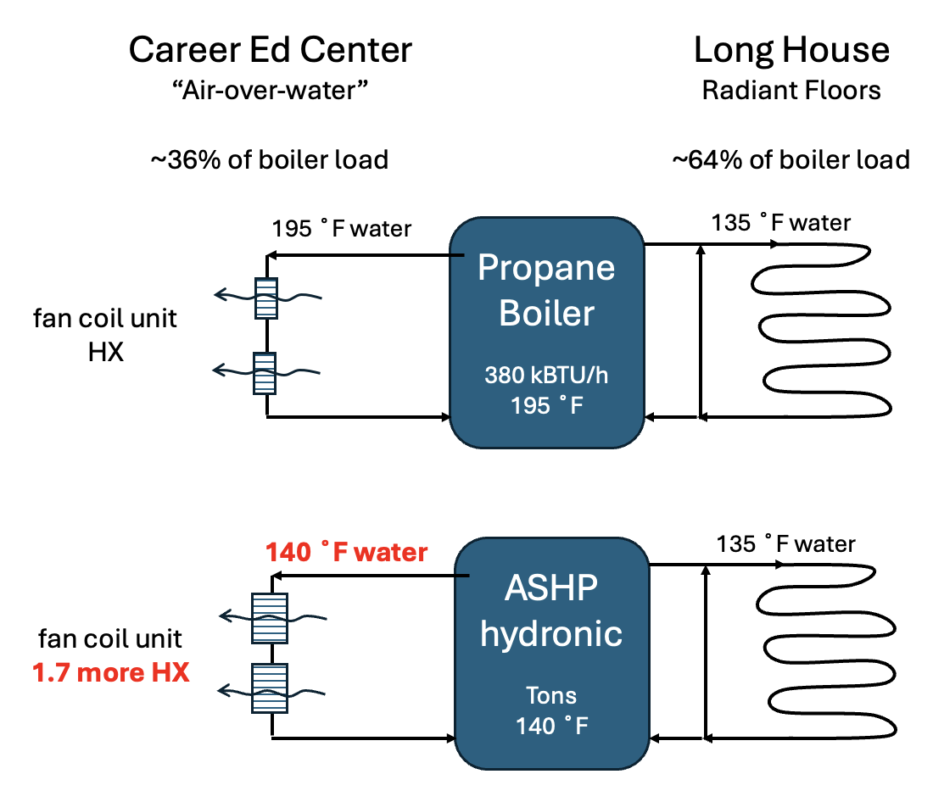
Impact of exchanging boiler with a hydronic heat pump system

Slide 4
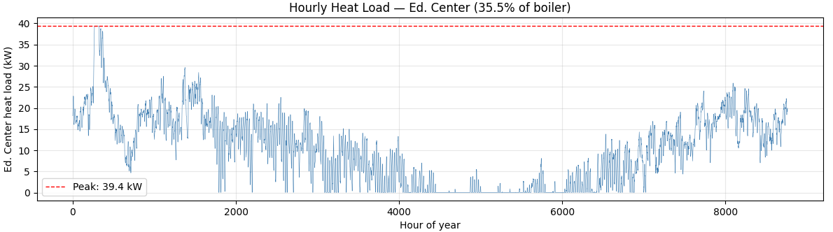
HX Analysis Details
Ed. Center Load Profile
Boiler annual load × 0.355 = Ed. Center annual load
Peak = 39.4 kW
⇒ FCU’s must supply ~40 kW to handle winter peaks.

Slide 5
HX Analysis Details
Scaling FCUs
Results
⇒ FCU size impacts power output
⇒ A 50॰F EWT drop results in 31-34% power reduction
FCU Model | 190॰F Power [kW] | 140॰F Power [kW] | % Reduction | Scaling Factor
HE-Z 50/RPM-50 | 16.5 | 11.4 | 0.31 | 1.45
HE-Z 70/RPM-70 | 23.4 | 15.5 | 0.34 | 1.51
HE-Z 100/RPM-100-4 | 32.9 | 22.7 | 0.31 | 1.45
HE-Z 100/RPM-100-5 | 39.3 | 25.8 | 0.34 | 1.51

Slide 6
Impact of exchanging boiler with a hydronic heat pump system
1.45 more HX

Slide 7
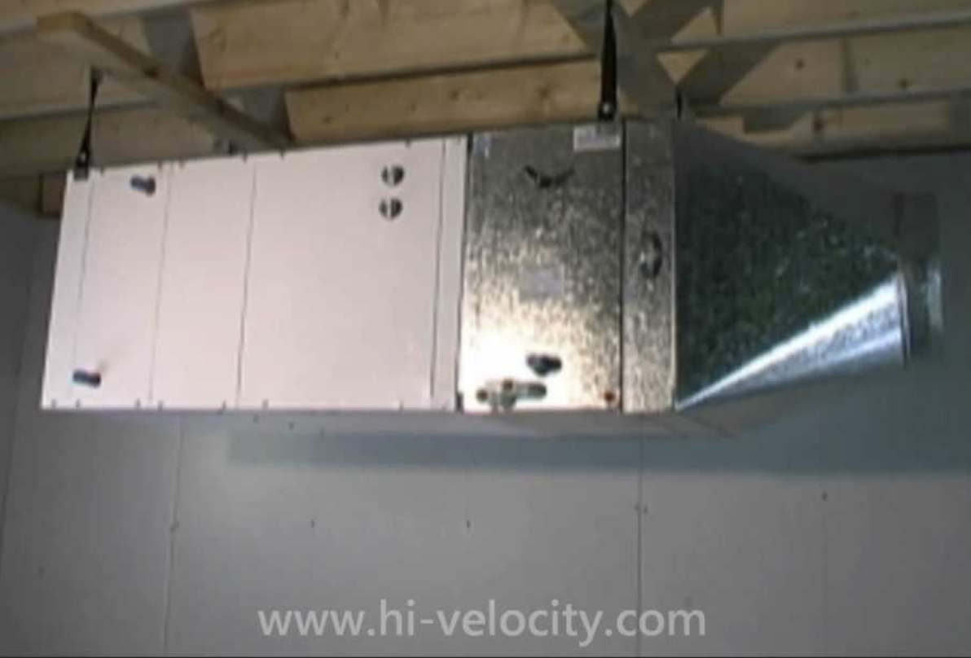
Using a real unit to ground estimates
Fan Coil Unit: Water-to-Air Heat Exchanger (HX) & Blower
The Hi-Velocity unit shown operates with entering water temp (EWT) from 130 ˚F to 190 ˚F
High EWT = Higher heat output
Lower EWT = Lower heat output
Going from Propane (195 ˚F) to a hydronic ASHP (140 ˚F) requires upscaling the FCUs by 1.45 X

Slide 8
HX Analysis Details
FCU CAPEX
Boiler heat exchanger
$2,000 - $4,500 replacement costs [1]
Heat pump heat exchanger
$2,000 - $4,000 replacement costs [1]
Amount needed depends on existing amount
⇒ Cost of HX retrofit is small in comparison to boilers or HP, supporting LTHP scenario.
[1] Rahn Industries, Heat Exchanger Replacement Cost Guide
Notes:
https://rahnindustries.com/2023/03/24/heat-exchanger-replacement-cost-guide/

Slide 9
Heating Device Scenarios: CAPEX
CAPEX numbers are highly variable
Vendors cannot give a concrete estimate without seeing site infrastructure
Obtaining a realistic estimate will require a site walkthrough and information on the specific model
Current analysis
Extremely rough ballpark estimates were developed
These are based on online catalogs and websites
Example heating device models (slightly oversized)
High degree of uncertainty

Slide 10
Heating Device Scenarios: CAPEX
Propane Boiler
~$28,000 for 399,000 Btu/hr unit and installation
LT-ASHP only
$30,800 units + $45,000 install + $8,500 retrofit
~$84,000 for 7x 14 kW units, installation, and retrofit
HT-ASHP only
$43,200 units + $45,000 install + $0 retrofit (assuming no retrofit)
~$88,000 for 6x 20 kW units, installation, and retrofit
Electric Boiler
~$25,000 for 100 kW unit and installation

Slide 11
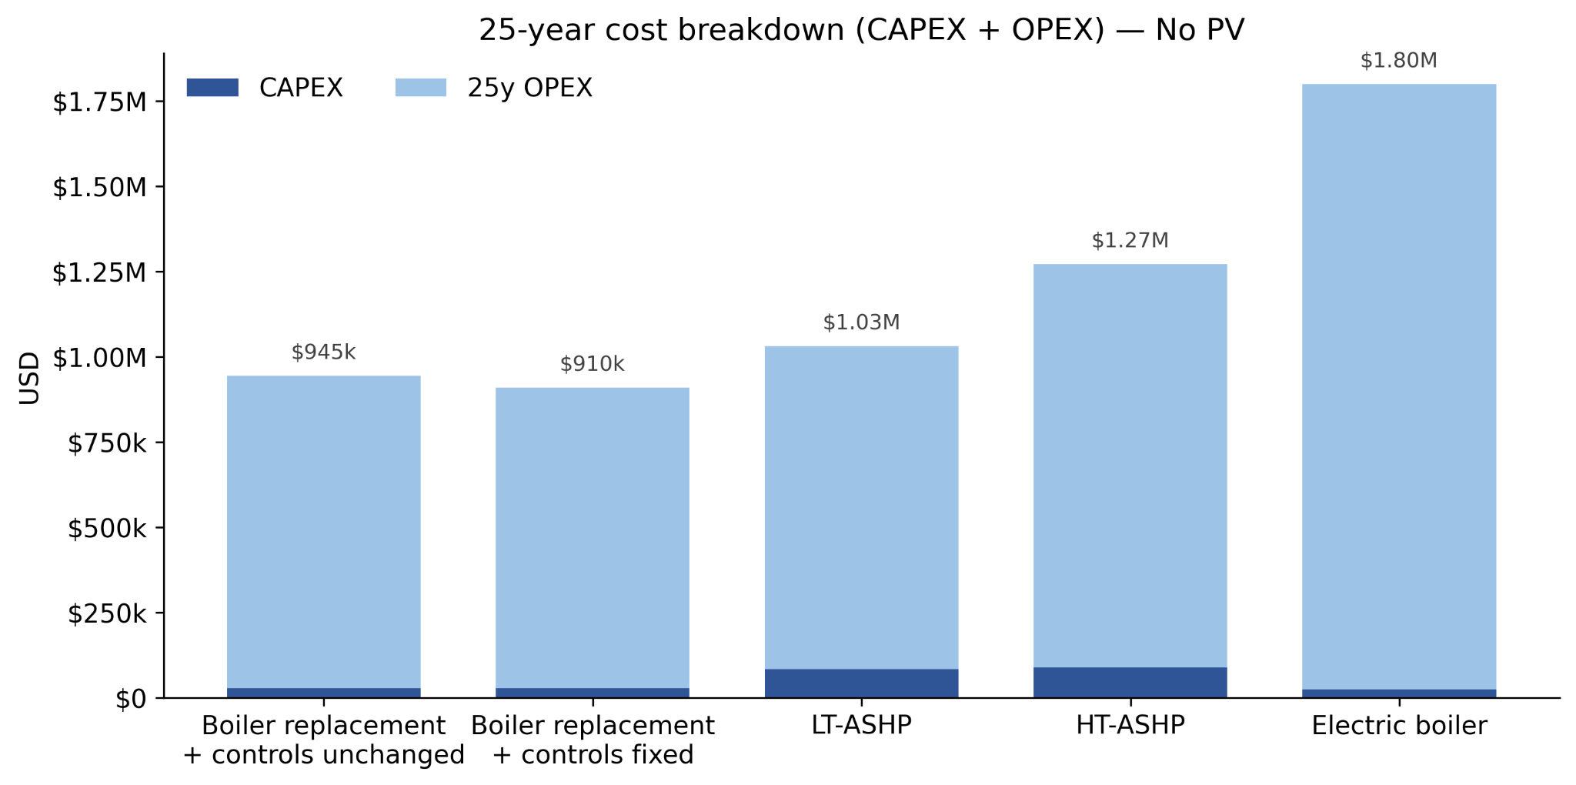
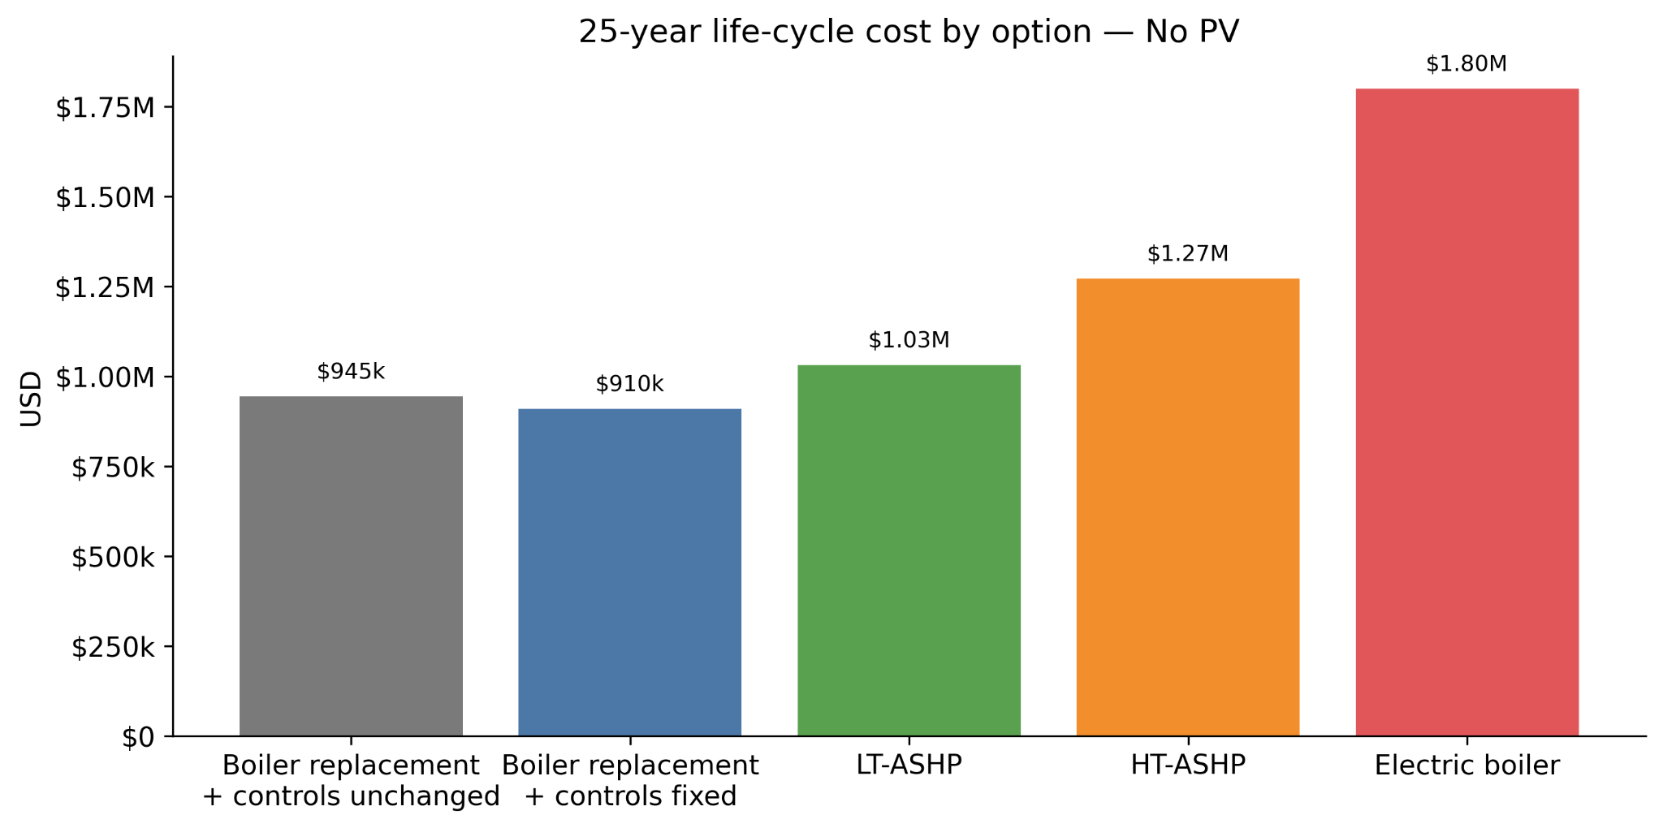
Heating Equipment Cost Comparison
Most of the 25-year total cost is operating cost (energy), not upfront equipment cost.
Recommendation: LT-ASHP is the most economical choice unless retrofit costs come in very high or electricity prices fall.

Slide 12
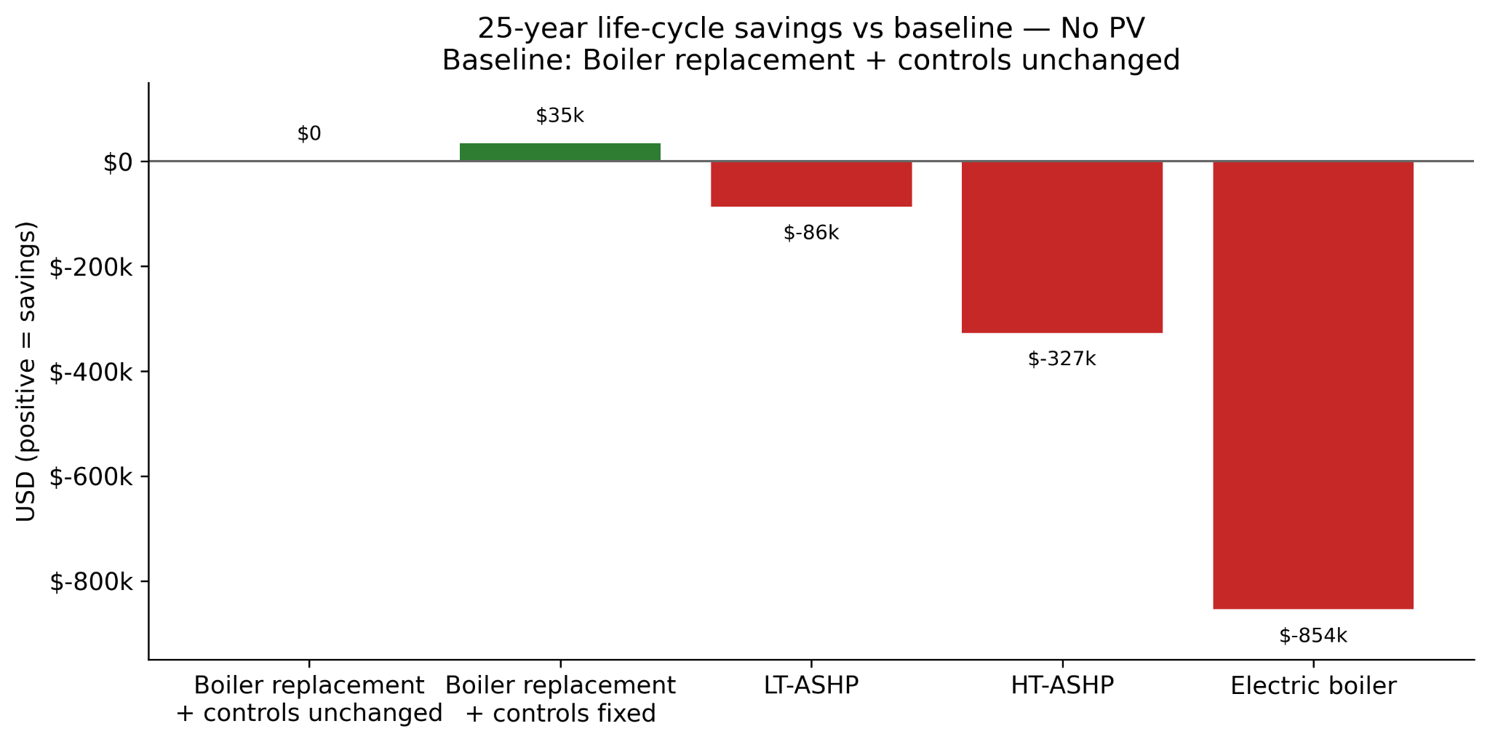
Heating Equipment Cost Comparison
Key takeaways:
Heat pump options increase 25-year cost vs. baseline under current assumptions; electric boiler is the highest cost option.
Addressing controls will reduce long-term costs regardless of electrification path.

Slide 13
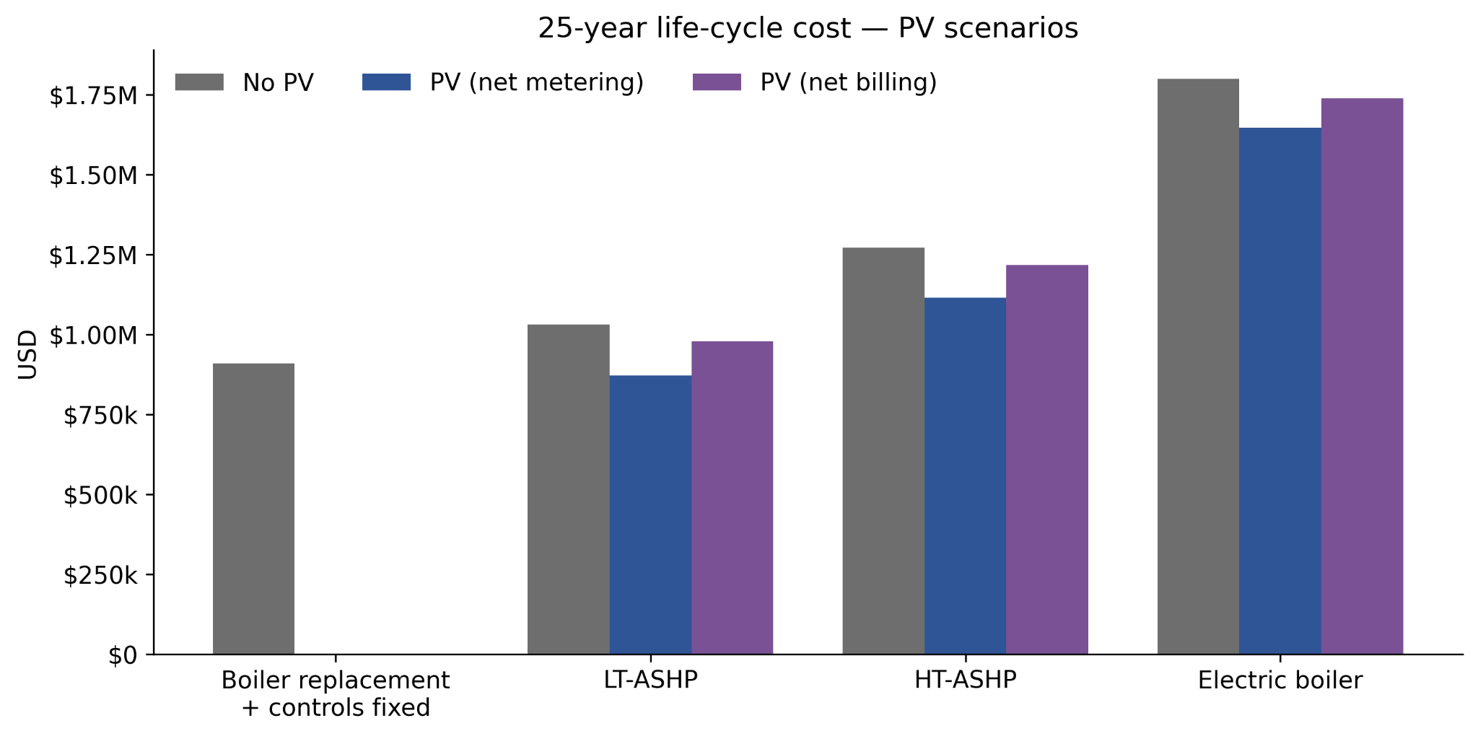
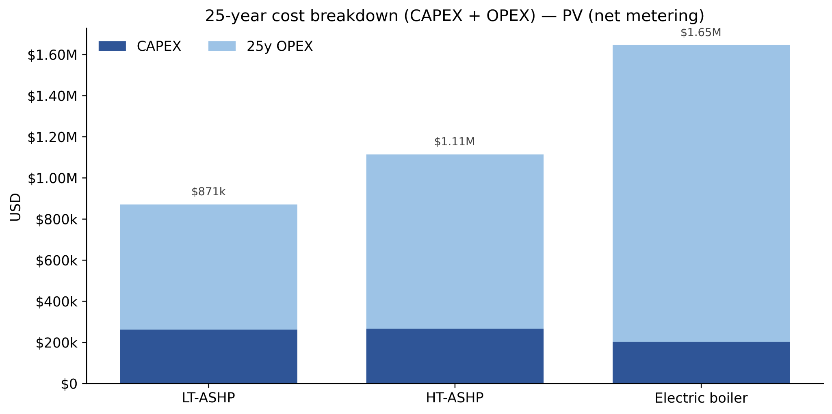
PV Cost Comparison
Key takeaways:
PV leads to significant savings for all scenarios over a 25-year time horizon despite high CAPEX
Net metering outperforms net billing

Slide 14
Battery Findings
Battery “Savings” over 25-year time horizon:
Heating equipment | Net metering |  |  | Net billing
 | 1 hr battery | 2 hr battery | 4 hr battery | 1 hr battery | 2 hr battery | 4 hr battery
LT Heat Pumps | -$41,845 | -$52,457 | -$73,716 | -$36,059 | -$41,437 | -$52,785
HT Heat Pumps | -$75,850 | -$101,167 | -$153,542 | -$62,314 | -$75,304 | -$111,334
Electric Boiler | -$119,482 | -$164,980 | -$263,205 | -$95,772 | -$126,508 | -$212,489
Free capital runs indicate that batteries generate negligible returns under net metering and modest returns under net billing (~$400/yr for LT-ASHP, ~$1,000/yr for HT-ASHP, and ~$2,000/yr for electric boiler)
Battery bleeds money at full cost, and grant funding is hard to justify unless considering resiliency.

Slide 15
LT-ASHP: Schedule 24 vs. Schedule 25
Estimated peak demand ~51 kW
Near Schedule 24/25 threshold (50 kW)
Schedule 24: lower monthly fixed charge and no demand charge but higher electricity cost ($/kWh).
Schedule 25: higher monthly fixed charge and demand charges but lower electricity cost ($/kWh).

Slide 16
LT-ASHP: Schedule 24 vs. Schedule 25
Case | Full cost (25-yr) |  | Free capital (25-yr)
 | Schedule 24 - Schedule 25 |  | Schedule 24 - Schedule 25
No PV | -$72,350 |  | -$21,953
Net metering | $20,007 |  | $7,512
Net billing | -$46,303 |  | -$13,199
Schedule 24 improves LT-ASHP economics only under net metering; it is worse than Schedule 25 for the no-PV and net-billing cases.

Slide 17
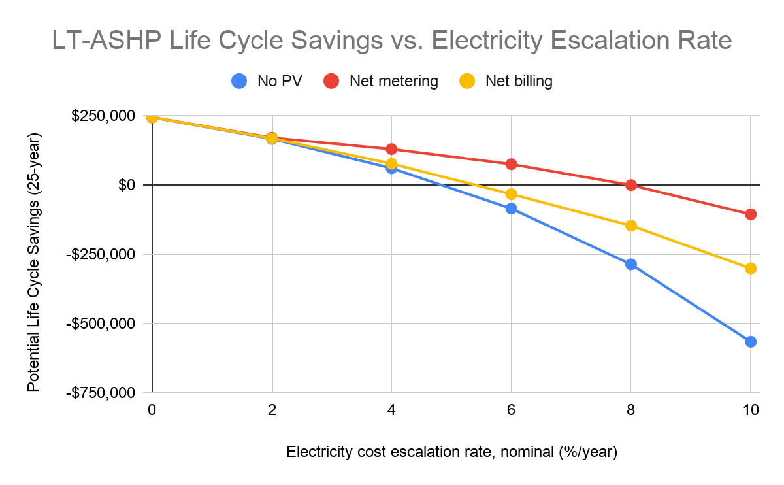
Escalation Rate Sensitivity Analysis
Electricity escalation rate
Increased escalation rate decreases life cycle savings exponentially (for all PV scenarios)

Slide 18
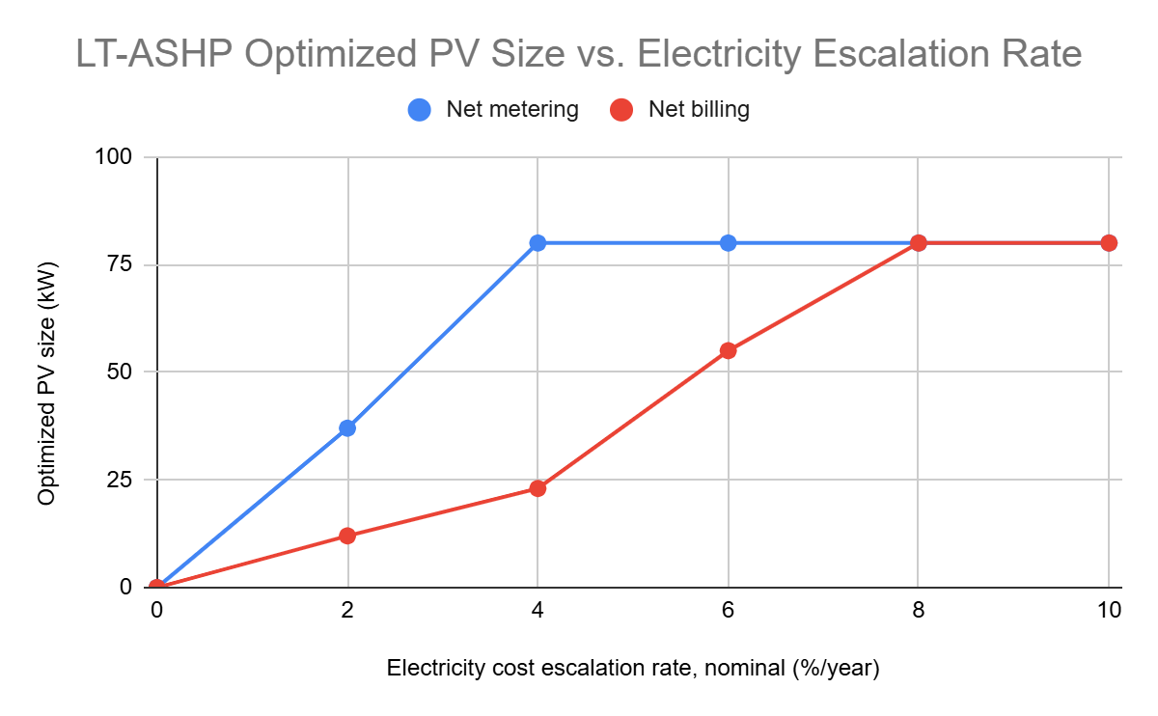
Escalation Rate Sensitivity Analysis
Electricity escalation rate
High rate increases the benefit of PV → higher optimized PV size (up to maximum)
More dramatic effect for net metering

Slide 19
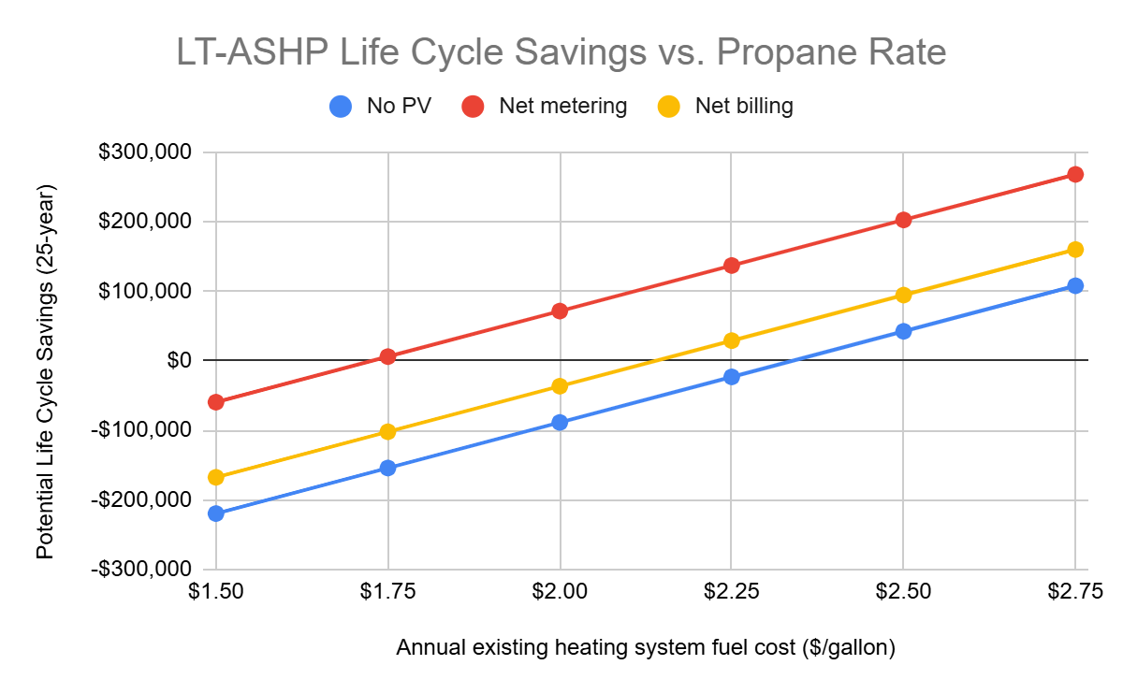
Propane Rate Sensitivity Analysis
Propane rate
Explored instead of propane escalation rate due to REopt limitations
Positive linear relationship between life cycle savings and propane rate (due to lack of REopt escalation)

Slide 20
Next Steps
CAPEX cost ranges and approximating error
June 4 — Community Capstone Showcase
June 15 — Final report delivered to PGST

Slide 21
Thank you!

Slide 22
Heating Device Scenarios: CAPEX
Propane Boiler
~$28,000 for 399,000 Btu/hr unit and installation
LT-ASHP only
$30,800 units + $45,000 install + $8,500 retrofit
~$84,000 for 7x 14 kW units, installation, and retrofit
HT-ASHP (CEC) & LT-ASHP (Longhouse)
$42,000 units + $45,000 install + $0 retrofit (assuming no retrofit)
~$87,000 for 3x 20 kW & 4x 14 kW units, installation, and retrofit
Electric Boiler
~$25,000 for 100 kW unit and installation

